Slide 1

ALL TEH METADATAS
Re-revisited
2013 code{4}lib Meeting
February 13, 2013
Esmé Cowles Matthew Critchlow Bradley Westbrook

Slide 2

Overview
Overview
Needs Assessment
Data Model Process
Implementation
Needs assessment and proposed solution
Data modeling
Tool implementation
Notes:
Hi. I am Brad Westbrook. This is Matt Critchlow, and this is Esme Cowles. We would like to thank you all for selecting us to present this morning.
We are going to tell you part of a continuing story. Declan Fleming told an earlier part of this story last year, and that part concerned how UCSD had implemented RDF for its Digital Asset Management System beginning in 2004 and how it hopes to move its DAMS into the linked data environment.
In our part of the story, which is still more toward the beginning than the end, we are going to describe some of the barriers we found standing between the UCSD DAMS and the linked data terminus envisioned in Declan’s previous talk and what measures we are taking to get past those barriers.

Slide 3
Overview
Needs assessment and proposed solution
Data modeling
Tool implementation
Needs Assessment
Brad Westbrook
Notes:
I am going to briefly describe four key areas that we decided needed to be addressed to improve the functionality and sustainability of the UCSD DAMS.

Slide 4
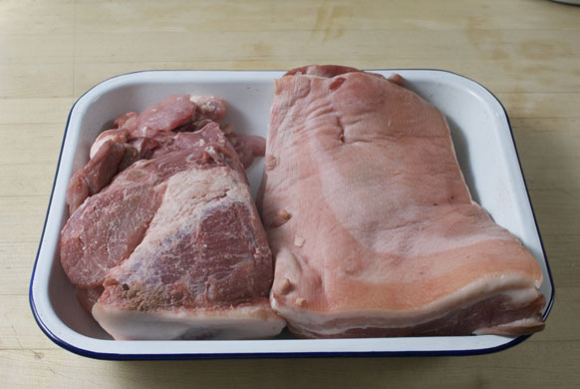

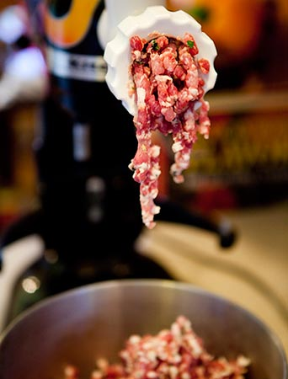
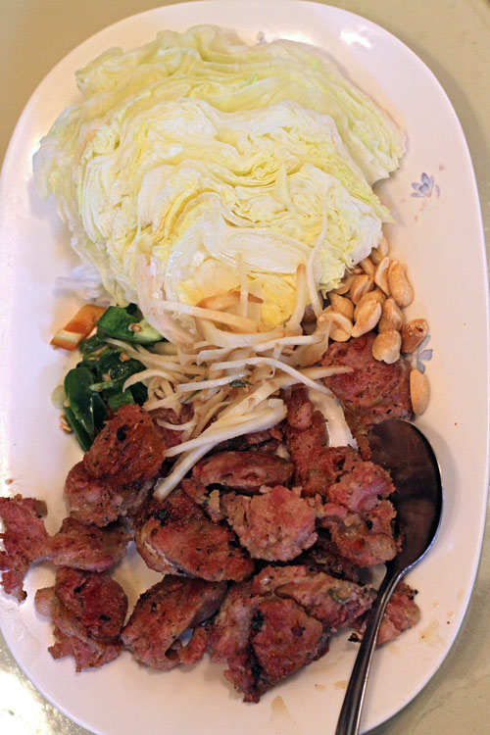
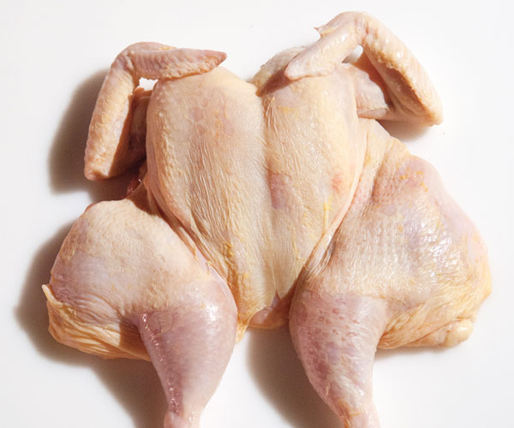
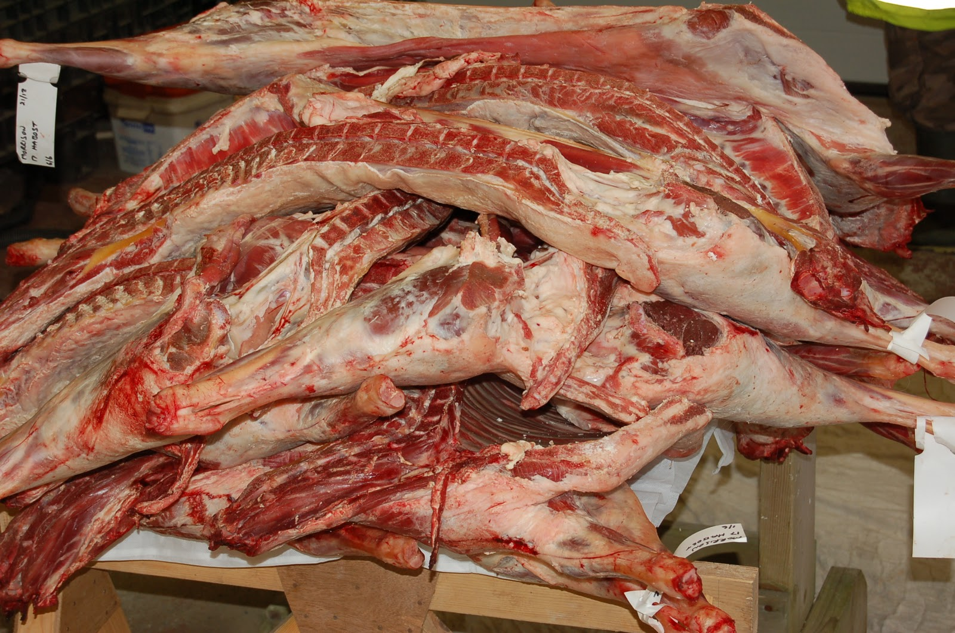
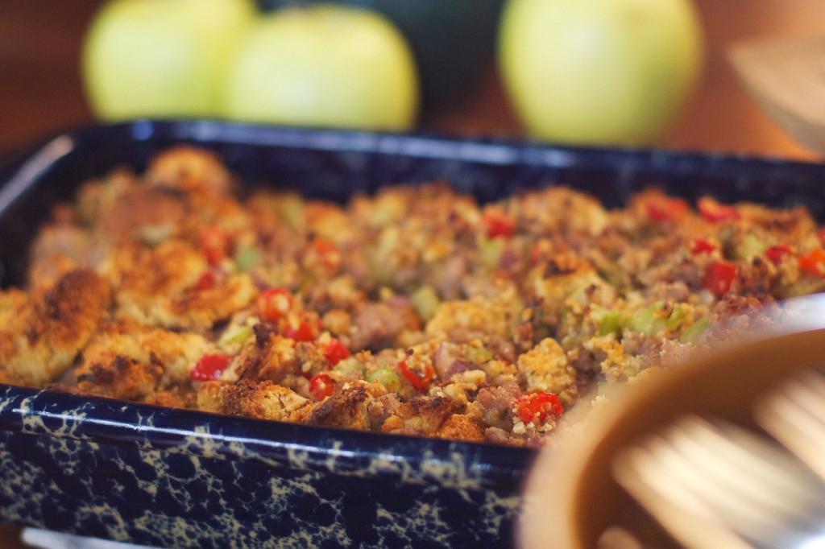
Need One: More consistent data
Notes:
The most basic need we have is to improve the consistency of the metadata in the DAMS.
ANIMATION ONE
We acquire highly variable content files and metadata. **** Metadata may come in the form of comma separated values, Excel spreadsheets, MODS exports from the Archivists’ Toolkit, and MARCXML generated from our ILS. Some of the metadata we acquire was created according to established content and format standards. Other metadata has no standard behind it. Some metadata is very thorough, including titles, statements of responsibility, dates of creation or issuance, notes, and even subject and name headings. Other metadata can be very scanty and has to be supplemented as best as possible during the ingest process.
ANIMATION TWO
**** We normalize content files to supported file formats through the file ingest process, and we normalize acquired descriptive data through what we call the assembly plan process. As Declan described in his presentation last year, UCSD’s assembly plan process is a specification for stamping out object records for a class of objects, the class usually being defined by provenance. The assembly plan is engineered to insure that all objects in the DAMS have metadata elements and formats necessary to support rudimentary object interoperability within the DAMS and, moreover, that a class of objects is described similarly.
The assembly plan as it is handed to ETL staff is expressed in XML and references the MODS, PREMIS, MIX, and METS schema. ETL staff, of which we have four, then use XSLT to transform the XML into RDF.
ANIMATION THREE
Since the start of our work in 2005, the transformation from XML to RDF has been highly artisanal. **** Each ETL staff has created her or his own stylesheet for producing the transformations. Unfortunately, during this time there was no explicit data model to help control the stylesheets for uniformity. Consequently, uniformity among objects established in the assembly plan process is erased in the RDF transformations. These differences impact object interoperability, UI display, and, of course, user experience.

Slide 5
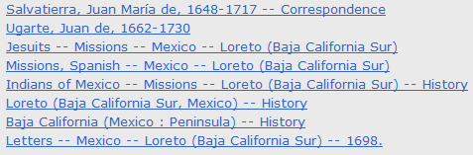
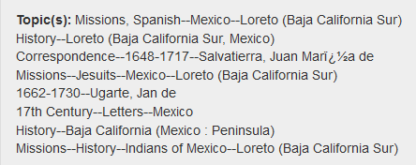
Need Two: Maintain syntax of hierarchical subjects
Notes:
The second need we identified was to discover a way to maintain the syntax of hierarchical name and subject headings inherited from MARC records. MARC records are the source for approximately 70% of the DAMS object records.
As this illustration indicates, the syntax of subject headings from a MARC record is corrupted in the RDF transformations. In this particular case, only one subject heading of the eight in the source MARC record is correctly transformed to RDF. All the rest are scrambled, with the primary term being demoted one or more levels in the hierarchy. One subject heading, in fact, acquires information not present in the source record.
Needless to say, this problem also impacts searching and interpretation of the digital assets in the DAMS. It also reflects poorly on the Library’s metadata staff.

Slide 6
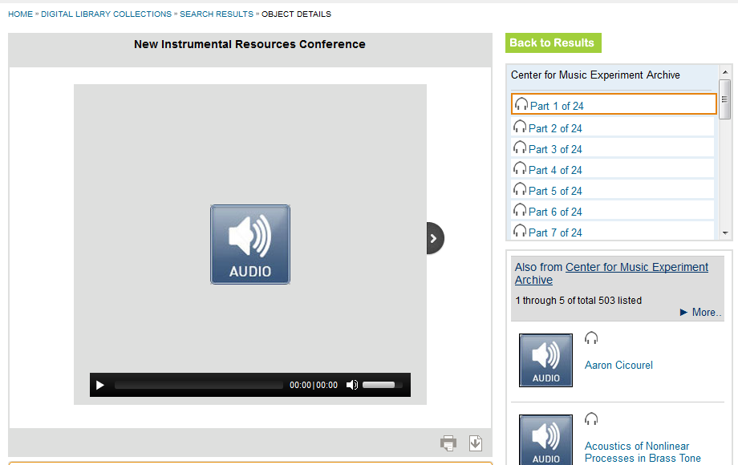
Need Three: Improve support for complex objects
Notes:
A third area we found needing improvement is our presentation of the many complex objects in the DAMS.
A complex object is a multi-part object with components and metadata at component levels. The components may be few or many.
The complex object record includes two structure maps. One is a physical map that simply represents the sequence of the files comprising the object. The other is a logical map that correlates components with any descriptive or rights metadata they might have.
The current DAMS digital object viewer provides only the physical file map. In this example it is a scrollable list of 24 components.
The audio file reflected in the viewing pane is the file for the first of the 24 components. But there is no way within the digital object viewer for a user to know that the audio file contains a discussion by three musicians about another musician’s technique.

Slide 7
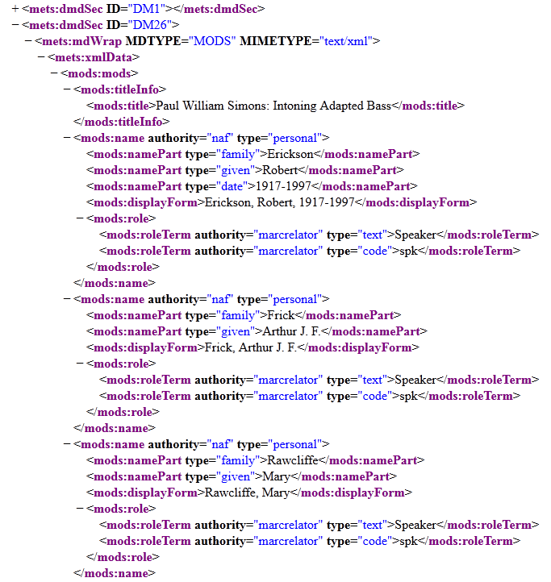
Improve support for complex objects-2
Notes:
But that metadata is in the object record, as this XML representation of the second component indicates. The descriptive metadata includes a title and names of presenters, as well as indication of what exact day of the multi-day conference the presentation occurred. This is all important information for navigating the 24 parts of the object.
Because of this limitation, patrons and reference librarians have found the digital object viewer very difficult, in fact nearly impossible, to use for navigating multi-part objects. They can move through the nodes but they have no idea what a node contains until they activate the file.
To help patrons understand and navigate complex objects, our public service librarians have often had to resort to using the Archivists’ Toolkit, which is only deployed at UCSD as a staff side authoring tool for complex digital object metadata.
This extra step is very inconvenient to patron and staff and leads to considerable frustration.

Slide 8
Need Four: Align more strongly with DL community
Make sure UCSD RDF is public facing
Use vocabularies in the public
Make UCSD vocabularies public
Develop technology stack
Utilize contributions from non-UCSD sources
Contribute to non-UCSD endeavors
Notes:
The fourth area of need is to align our DAMS more strongly with the digital library community.
We want to do that on a Micro-level by making sure our RDF is outward facing so we can utilize public vocabularies and also make our own vocabularies available for use by others.
And we want to do it on a Macro-level by making sure we are developing a technology stack that can be shared with others and that others can contribute to, should they like.
Our past methods have been tightly insular and, were they continued, would force us to make every vocabulary and technical advance by ourselves.
We see strengthening our alignment with the community as the most important pathway toward a cost-effective, generally-purposed, and sustainable digital asset management service for UC San Diego and for others.
These needs, especially the desire for stronger community alignment, triggered data modeling and implementation work over the last 10 months that Matt and Esme will now describe.
ADVANCE TO NEXT SLIDE

Slide 9
Data Model Process
Matt Critchlow

Slide 10
Project Overview
Research Data Curation Pilot Deadline: June, 2013
Timeline: July 16, 2012 – Oct 29, 2012
Deliverables
Abstract Data Model
OWL/RDF Ontology
Data Model Extension Guidelines
Team
Metadata Analyst: Arwen Hutt, Bradley Westbrook
IT: Esmé Cowles, Matt Critchlow, Longshou Situ
Notes:
In addition to the needs Brad just described, we found ourselves facing a very real hard deadline for our Research Data Curation Pilot Program.
This deadline is what ultimately crystalized the need to prioritize this project.
our Digital Library steering committee gave us a:
Timeline of 3 months
Asked to provide:
- abstract data model
- An OWL/RDF ontology.
- Documentation for extending and modifying the data model over time
Team
balance of metadata analysts and it development staff.
Address the previous gaps in understanding and communication that Brad described. Nothing lost in translation in this project / going forward
Cross Section of RCI and the DLP (critical). The scope of our DAMS system has grown, and is not only internal library collections anymore.

Slide 11
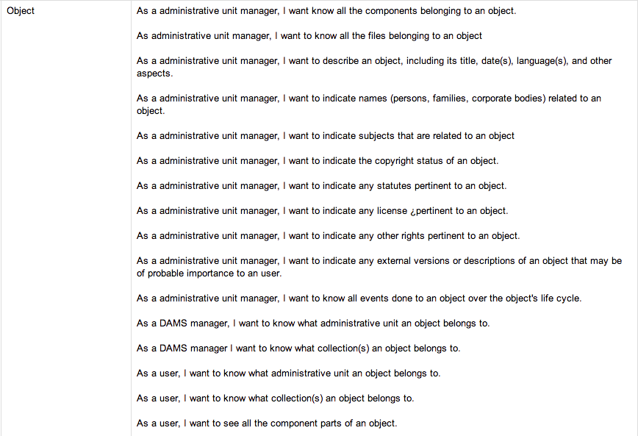
User Stories
As an administrative unit manager, I want to indicate any external versions or descriptions of an object that may be of probable importance to a user
As a user, I want to know what collection(s) an object belongs to
As a DAMS manager, I want to know what administrative unit an object belongs to
Notes:
So with the goal of representing the needs of both the Library and the research community on camps,
our team decided to generate a user stories document for the data model project
Focusing here on the Objects, you can see various roles called out like administrative unit manager, DAMS manager and end user
-
After an initial pass at these user stories, we moved on to creating the requested deliverables themselves.

Slide 12
Abstract Model – High Level
Notes:
The first phase of the project involved the creation of an abstract data model as our domain definition
we began with a high level entity relationship diagram, calling out the core base classes:
Collection, Object, Component, and File
And the various relationships between them
If we had stopped here, we probably would have finished in a few weeks.
But it would have also been a pretty useless data model

Slide 13
Abstract Model
Collection
Name
Object
Relationship
Role
Component
Notes:
The next step was to create a flushed out abstract model
The diagram has those same core classes of from the previous slide
But we have added modeling for Rights, events and descriptive metadata, and their relationships and inheritance structure
Our current data model, as Declan talked about last year, is very flexible in the definition, re-use, and modification of predicates for our RDF triples
Which gives us the ability to make global changes with relative ease. and this capability will be carried forward into the new system
But the RDF triples are almost all stored inline with each object. And that’s something we wanted to change.
Take Names for example, particularly the Name/Role Relationship.
The main UCSD Library building, shown on our first slide, is called the Geisel Library. It’s named after Theodore Geisel who we all know and love as Dr. Suess.
As a result his generous donations, we have a number of Dr. Seuss collections in our DAMS.
Many of these objects each have a set of RDF triples of a the name Theodore Geisel and the Role, creator.
We wanted to move towards a linked data approach where the Geisel name could stand on its own an object with an ARK, our permanent UID, that can also include external authority references like LOC SH and NAF
And then, that name object could be referenced by collections, objects, components as needed.
So we created our abstract model with this goal in mind.
The next step was mapping this ERD diagram into a Data Dictionary

Slide 14
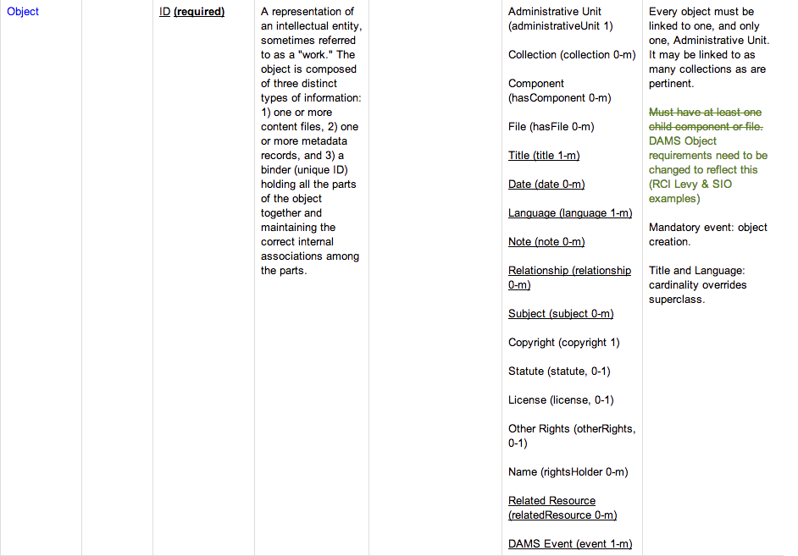
Data Dictionary
Title (title 1-m)
Copyright (copyright 1)
Language (language 1-m)
Administrative Unit (unit 1)
Relationship (relationship 0-m)
Notes:
The data dictionary is represented as an enormous table of class hierarchy, properties, controlled vocabulary references/lists, constraints and notes
Just a couple comments about it:
While our objects can certainly be very richly described, as you’ve seen on previous slides already, we wanted to allow for a wide range of description
SO in our new data model, an object only needs to have a title, a copyright statement, a language, be associated with a Administrative Unit
Note that: Object doesn’t have to have a file
This was a relatively recent requirement that surfaced in our research data projects, and one we wanted to call out and support.
Traditionally, we have always required an object to have a file, as part of its definition.
2. This document was the transitioning point between the abstract modeling and creating an ontology.
As a result this is where we spent a lot of our time in the project
It was at this point that we began looking closely at standards we were familiar with, such as MODS, PREMIS, MIX, Dublin Core
And then began looking for ontologies built on these standards we could use for our data model
Continuing with our Relationship example, we defined that an Object can have 0 to many Relationships as Name/Role pairs.
The question we had to start asking ourselves then were:
How to model the Names, Roles, and relationships from an ontology we know of?
OR
are there other ontologies we should be considering instead?
OR
Is there nothing that directly covers a particular need, and we need to, at least temporarily, model it ourselves?
These were the kind of questions we needed answers to as we started creating our Ontology in Protégé

Slide 15
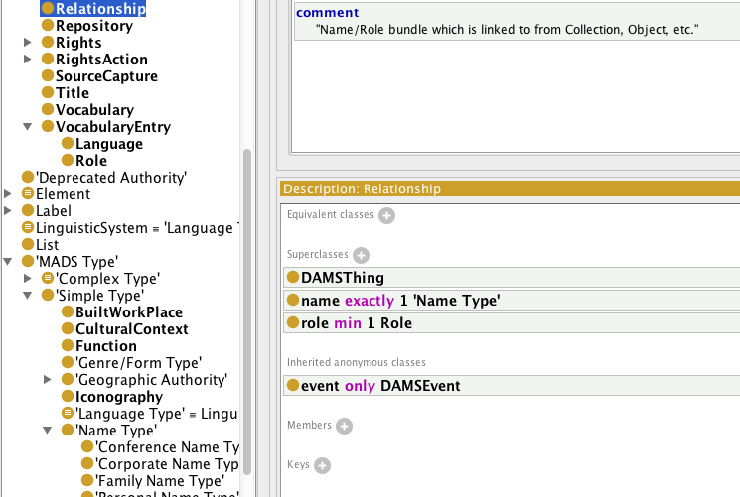
Ontology
Notes:
With Names, we were fortunate to find our answer in the MADS ontology.
MADS stands for Metadata Authority Description Schema and is available on the library of congress website.
It has a specification for Names, as well as Subjects, that aligned really well with our needs
So we were able to define in our ontology that a Relationship consists of:
one MADS name type (Conference, Corporate, Family or Personal Name)
At least one Role. Our Roles controlled vocabulary is the MARC relator codes. Also available on the LOC website.
With Rights metadata we were less fortunate. We found the PREMIS draft ontology, read through it, and pulled it into Protege to review it.
but it is still in draft form, and we need a working solution now.
Not just because of our deadline, but also because our rights metadata drives our access model in the DAMS.
So we found ourselves striking a balance between leveraging a community standard ontology like MADS, and creating a PREMIS-like rights metadata implementation locally
To be clear, our intention is that when the PREMIS ontology is in a production state we will adopt it in place of our local implementation.
These are just two examples, but they’re very indicative of how the ontology creation process went for us
I want to close before I hand things off to Esme with a little more Dr Seuss

Slide 16
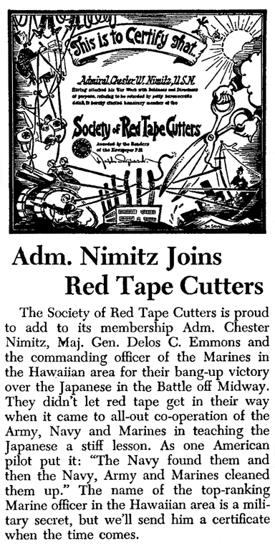
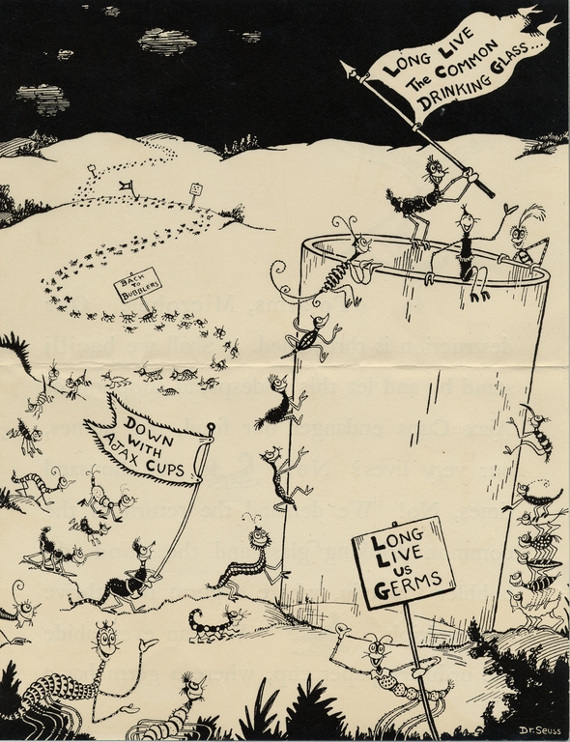
Thing 1, Thing 2
Notes:
Two images created by Dr. Seuss that are from two different collections in our DAMS.
L: Dr. Seuss Went to War Collection
R: Dr. Seuss Advertising Artwork Collection
Each have metadata properties that makes them distinct, but they also reference entities than can be shared
going back to goal of a linked data solution, we can now define the following in the new data model ->

Slide 17
Thing 1, Thing 2
Notes:
In this diagram
Specific properties to each objects. Title on left, Date on right
Shared entities that can be referenced by any object in DAMS
Each have a mads:Topic with a LOC SH
Each share the same relationship
MADS Personal Name - Dr. Seuss
Role - Creator
So in the span of a few months, we ended up with a new data model that we’re pretty proud of
Esme is going to catch you up on what we’ve been working on since November->

Slide 18
Implementation Esmé Cowles
Notes:
Implementation phase includes people from our digital library program, research data curation program, metadata analysts, and developers.

Slide 19
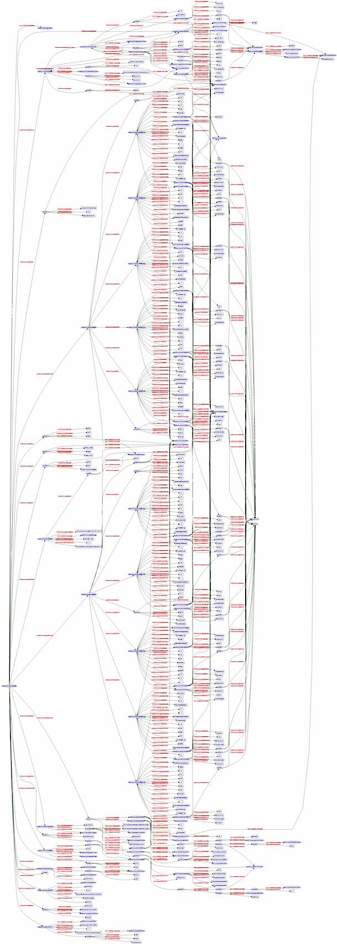
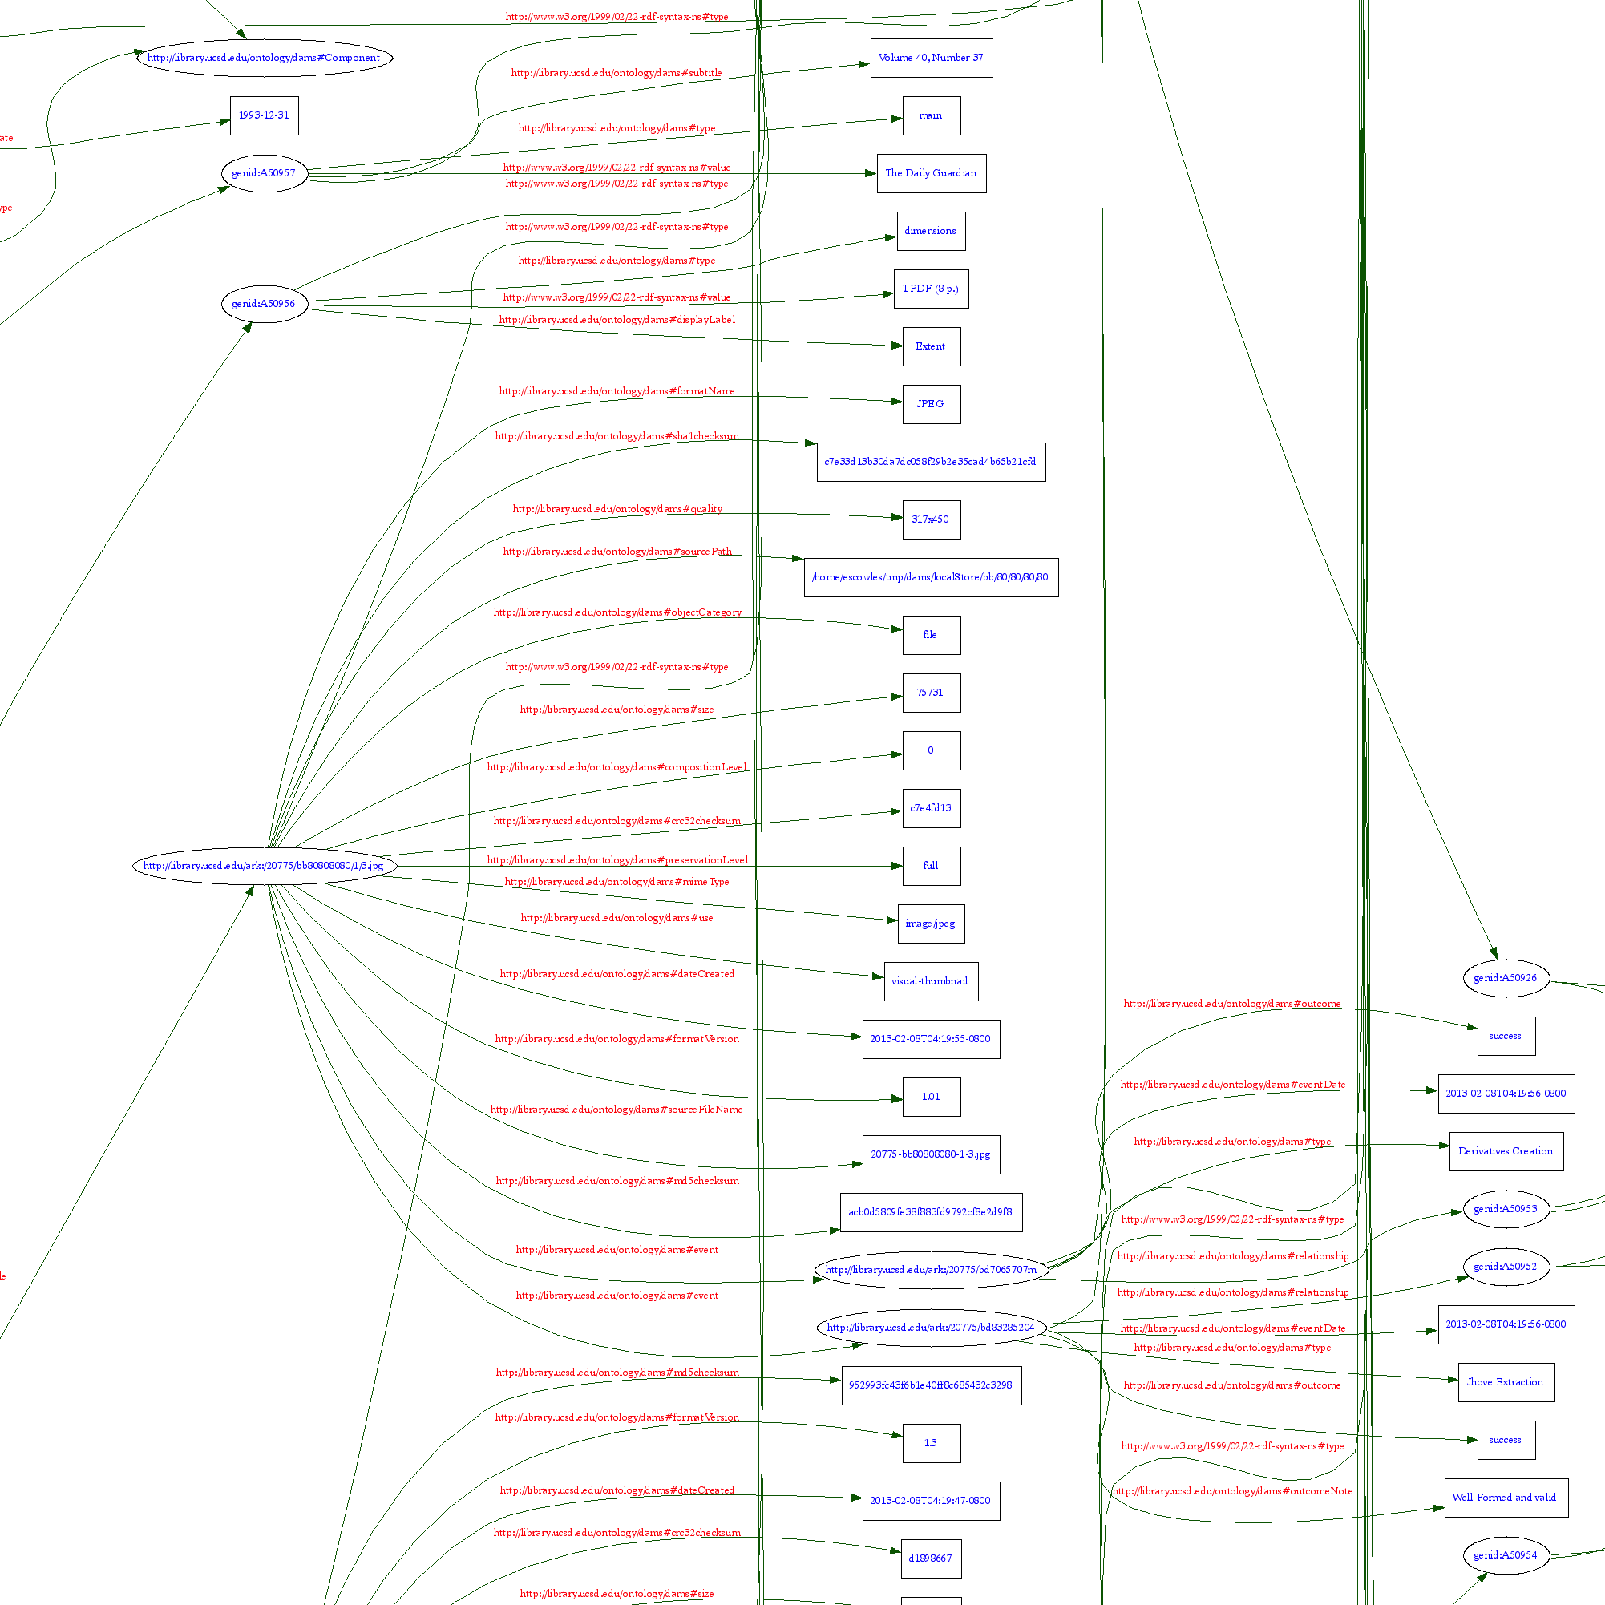
Notes:
Our data model got a little more complex, so we knew we’d need to make some pretty substantial changes.

Slide 20
DAMS Repository
New version of our lightweight repository
Metadata in triplestore
Files on disk or cloud storage
Explicit structural metadata
Native REST API
Fedora REST API (partial)
Notes:
New version of our repository to handle new data model.
Same architecture: triples and files. Cloud storage.
Big change is consolidating our servlets into a coherent REST API
Partial clone of the Fedora REST API.

Slide 21
DAMS Manager
Separate Java webapp
Ingest, batch operations
Uses DAMS Repository REST API
Functionality moved into the repository
Characterization (JHove)
Fixity checking
Derivatives (ImageMagick)
Notes:
Some changes to our administrative app (ingest, batch).
Big change is using the repository REST API
Used to talk to files and triples directly
Functionality moved into Repo, triggered by REST API calls.
File characterization with JHove
Fixity checking
Derivative generation

Slide 22
DAMS Public Access System
Old frontend is unsustainable
New frontend in Hydra
Backed by DAMS Repo, not Fedora
Hydra platform and community
Notes:
Biggest changes to frontend.
Our current frontend is a heavy, client-side Javascript application.
Have to maintain everything ourselves, all data is retrieved using AJAX so search engines don’t index our content, generally unsustainable.
Chose Hydra because of the platform and the community.
New to Rails and really liking it.
Really vibrant community.

Slide 23
Timeline
Started 2 months ago
Code sprint in January with cbeer and jcoyne
March: Beta release with research data
Spring: Migrating existing content
Summer: Production release
Notes:
We’ve gone from nothing to having a rough but working app in about 2 months.
Code sprint with Chris Beer and Justin Coyne really helped get us within striking distance of working system.
Beta release limited to research data in two weeks.
On track for migrating this spring, and release this summer.

Slide 24
One More Thing
We’ve talked about DAMS for years...
Now we have code to share
http://github.com/ucsdlib/
@escowles @mattcritchlow
bdwestbrook@ucsd.edu
Notes:
We’ve been coming to c4l since the beginning and taking about DAMS.
Now I’m very happy we have actual code to share.

